Slide 1

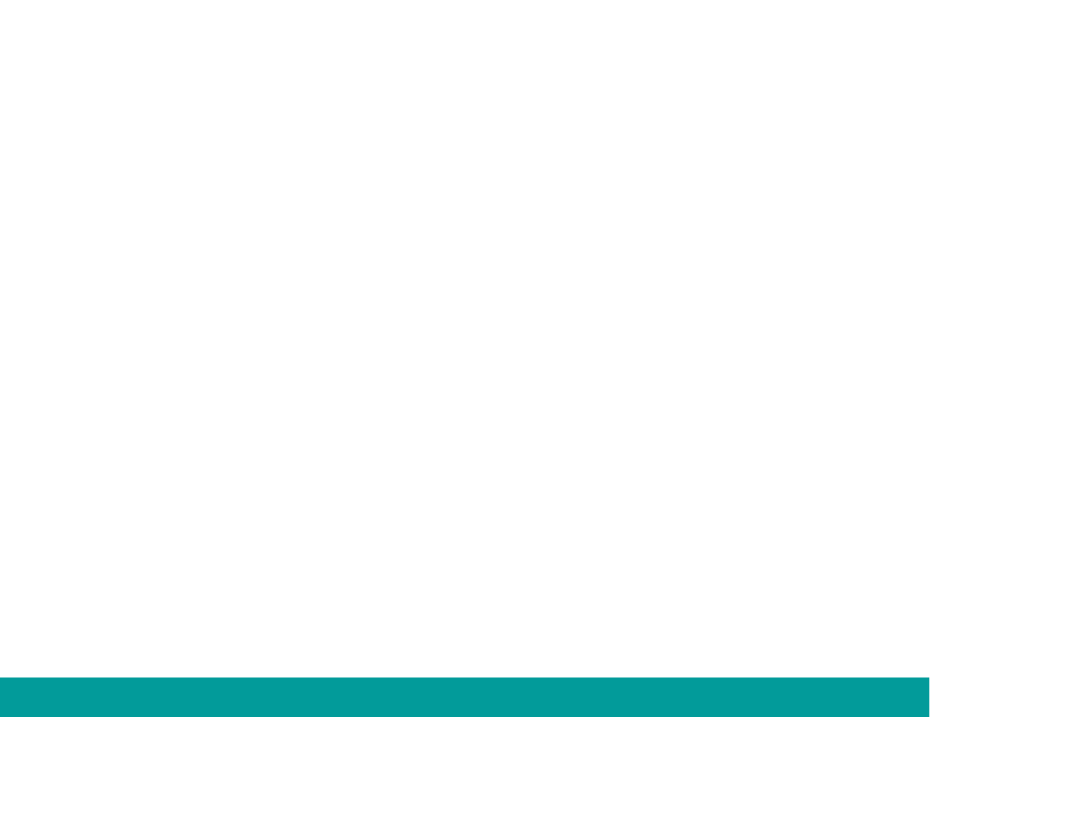

1882 Partnerships | Policy Discussion
February 2019 Community Meetings

Slide 2
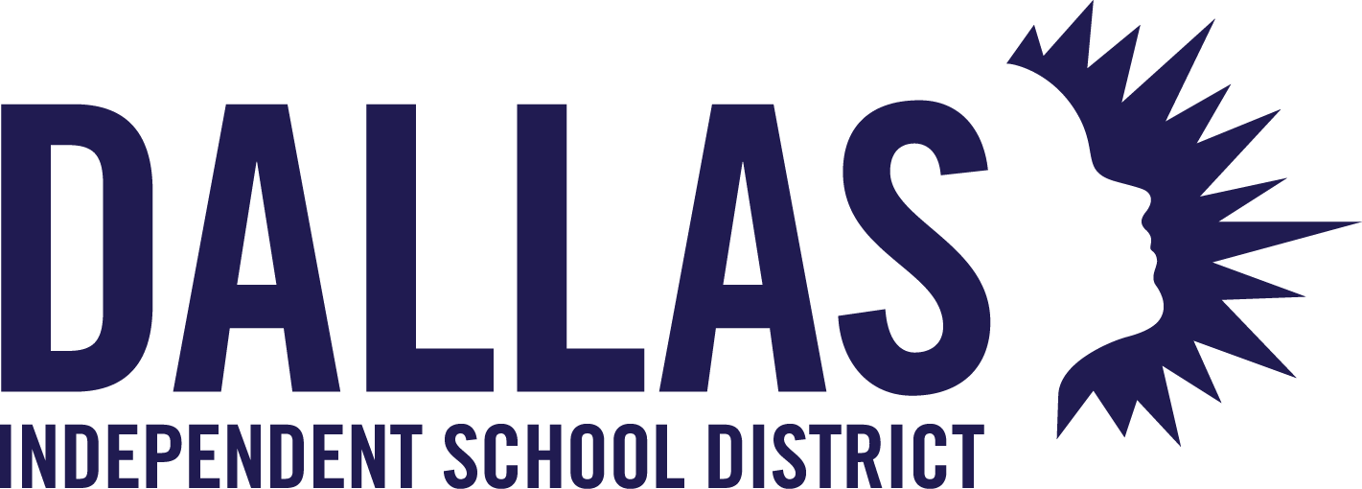
Senate Bill 1882 and Partnerships
What this is…
A way to get more state funding to Dallas ISD students
A way to provide more resources to Dallas ISD students
Limited to PreK partnerships
What this is not…
A takeover of public schools
Giving away our schools
Home Rule
An opportunity for charter schools
Notes:
Talking points:
This policy is...
A way to get more state funding to Dallas ISD students - expected to provide an additional $900/student (PreK students only get half of the $1,800 discussed before).
An opportunity to provide more resources to Dallas ISD students - all of the additional funding will be directed to support our students.
In response to community feedback, the policy is now limited to pre-kindergarten partnership sites only - this language has been added to the policy.
This means that no neighborhood schools or comprehensive schools of any kind will be considered for partnerships.
This changes builds on our existing work around PreK partnerships. Because we are already working with partners at the preK partnership sites, adding SB 1882 benefits allows us to get more funding and resources for these students without needing to change the way those sites are operated.
The extra funding from 1882 helps ensure that our PreK partners are stronger financially and able to sustain their critical work.
None of the existing prek partners are charter schools; charter schools will not be considered for future partnerships (this is specifically outlined in the policy).

Slide 3
How 1882 PreK Partnerships Will Work Building on an existing model
Notes:
Talking points:
Now we will look briefly at how the 1882 partnerships will work at our PreK partnership sites.

Slide 4




Current PreK Partnerships benefit children, families, centers, and Dallas ISD, creating a win-win-win
Benefit for children & families
  Enrollment in partnership classroom preserves consistency of setting between school & before/after care
  Support the workforce, as families need more than 7 hours the schools provide
  Teacher and curriculum are aligned with Dallas ISD K-2 and prepare students to be ready for kindergarten
  Student and family get to remain at location where they have built relationships and trust
Children
& families
Benefit for Dallas ISD
Benefit for partners
  Supports quality care for children 0-4, and before/after care
  Provides access to families and recruit them into Dallas ISD K-12
  Partner classrooms can operate at a decreased loss (compared to Dallas ISD classrooms)
  Provides quality supports through a certified Dallas ISD teacher, PD, and coaching
  Incentivizes enrollment in the center, which supports center finances, quality care for children 0-4, and before/after care
  Supports center teacher with stipend and co-teacher
Dallas ISD
PreK Partner
Notes:
Talking points:
Dallas ISD has had PreK partnerships (at non-Dallas ISD buildings) for more than a decade with Head Start.
In 2016, the Board of Trustees appointed an advisory council to explore how to strengthen those partnership models and allow for more traditional child care centers to come on board.
The Advisory Council recognized that having a strong child care community is vital to:
Children: they need strong care as a young infant and toddler, the most critical years of life
Parents: they need a safe, quality option for their child so they can go to work
Dallas ISD: the district needs children coming in at PreK or Kindergarten who have been well cared for and taught in quality locations
PreK partnerships are currently a central part of the Dallas ISD early learning strategy because of these benefits. They truly serve children and families, child care centers, and the district well

Slide 5
Current PreK partnerships are driving the increase in PreK enrollment
Partnership growth has supported overall PreK enrollment increases
Ten current PreK partners will join 1882, located throughout the district
PreK Partnership Enrollment
993
+1,121
2,114
students
2013-14
students
2018-19
Total PreK Enrollment
9,365
+3,599
12,964
students
2013-14
students
2018-19
Note: 1. Total enrollment does not include EC students, which are typically counted. 2. 2018-19 total is still preliminary.
Notes:
Talking points:
Dallas ISD has continued to expand PreK each year, adding more than 3,000 students in the past four years.
That growth has been in large part due to the expansion of PreK Partnerships, whereby the district works with Head Start and child care centers.
PreK partnership enrollment has increased by more than double in the same time period, expanding to 130 classrooms at 30 different locations.
PreK Partnerships serve a student body that is more than 50% African American.
Of the current partnership sties, 10 are pursuing 1882 partnership for the 2019-20 school year. This will be a simple conversion from their current partnership model to 1882.
Only existing PreK partners are being considered for 1882 partnerships at this time. Each of these sties currently has a Dallas ISD teacher and Dallas ISD students.

Slide 6
1882 PreK Partnership Model
Building off of current SRI PLUS concept, but improving revenue sharing for district and partner
1882 Enhancement
Current SRI PLUS
1882 Model (FINAL)
Purpose | Funding
Teacher Stipend | $5,000
Admin Support | $5,000
“Rent” Coverage | $3,000
Revenue Sharing | $7,000
Total SRI PLUS | $20,000
Purpose | Funding
Teacher Stipend | $5,000
Admin Support | $5,000
“Rent” Coverage | ---
Revenue Sharing | $7,000
1882 Revenue Share | $9,792
Total 1882 | $26,400
1882 Revenue Share
$900 per student x 13 students x 93% attendance x 90% pass-through = $9,792
Notes:
Talking points:
The 1882 partnership model simply seeks to enhance what the PreK advisory council built three years ago, which is a financially strong partnership that strengthens the child care community and expands choices for families.
The SRI PLUS model is what currently exists with the child care partners. Dallas ISD pays $20,000 per classroom per year to the partner in addition to providing a Dallas ISD teacher, PD, coaching, and supports.
Under SB 1882, Dallas ISD will get to recoup some of that (thus saving the district money) while at the same time increasing the financial support to the PreK partner.
The PreK Partner under SB 1882 will get a guaranteed (subject to enrollment ) $17,000 PLUS 90% of any 1882 revenue.
Side note: There are two Head Start organizations coming on board with 1882 – ChildCareGroup and Mi Escuelita – that will only get the 90% of the 1882 revenue. They will not get the $17,000. Head Start partners currently receive no funding from Dallas ISD because their per pupil is higher than the district’s, so they will only benefit from the 1882 funds. Still a net benefit to them and the district.
Because the state only funds PreK at a half-day rate, these 1882 PreK partnerships will receive about $900 per student as opposed to the $1,800 per student previously discussed.
Again, the 1882 PreK partnerships are simple enhancements to the work that Dallas ISD has been doing for years around expanding access to PreK.
Note: The “revenue sharing” is an effort to recognize an inequity in child care funding. It is the amount the district needs to pay to bring per student funding from child care subsidy up to what the district receives in per student ADA.

Slide 7
Appendix

Slide 8
1882 builds on existing work to expand PreK Partnerships
A summary of recent milestones
2016
2017
2018
2019
April: Board appoints PreK Partnership Advisory Council
Advisory Council meets seven times
Jan: Dallas ISD releases partnership application
Feb: PreK partners announced to Board
Aug: SRI PLUS partnerships launch
Jan. Dallas ISD releases 2nd partnership application
May: Dallas ISD applies for 1882 PreK Planning Grant
Aug: new SRI PLUS partnerships launch
Sept: Board approves 1882 Planning grant
Sept./Oct:: Adv. Council meets re: 1882 partnerships
Feb: Board considers revised ELA (LOCAL), limiting 1882 to PreK
Feb. Board considers 1882 PreK partnership contracts
Notes:
Talking points:
Dallas ISD has been on a three year journey to aggressively expand PreK partnerships, beginning with the Board of Trustees appointing an Advisory Council in spring 2016
The work of that Advisory Council led to the SRI PLUS partnerships, whereby the district, for the first time, began paying child care partners
In 2018, based on feedback from the Advisory Council and partners, the district enhanced that model by doubling the amount it would pay partners (from $10,000 per classroom to $20,000).
In May 2018, Dallas ISD submitted a planning grant application to TEA to launch 1882 PreK Partnerships, with the intention of building on the existing work and securing more funding to support PreK
In September 2018, the Board of Trustees voted to accept that 1882 PreK planning grant
Dallas ISD met again with its PreK Advisory Council in September and October of 2018 to plan for what 1882 would look like for PreK
In the February board meeting, the district is asking the Board to approve ten (10) 1882 partnership agreements for the 2019-20 school year.

Slide 9












PreK Partnerships Advisory Council Members
Trustee appointments
Derrik Sharp
District 1 (Flores)
Margaret Owen
District 2 (Marshall)
Birgit Scott
District 3 (Micciche)
Gayle Nave
District 4 (Resendez)
Alma Langrum
District 6 (Foreman)
Murriel Webb
District 9 (Henry)
Patricia Williams
District 5 (Blackburn)
Wendy Ogren
District 7 (Pinkerton)
Tori Mannes
District 8 (Solis)
Community Organizations
Susan Hoff &
Regen Fearon
Kathryn McCartney
Melanie Rubin
Van Sheets
Notes:
Talking points:
These are the PreK Partnership Advisory Council members. The trustees each appointed one member from their district in spring 2016 and then the citywide early childhood organizations each had a member.
The board received monthly updates in the Friday packet regarding progress of the Advisory Council throughout 2016 and part of 2017.
This group has continued to meet on an ad hoc basis to review the partnership models and plan out how 1882 should work for PreK purposes.

Slide 10

Summary of 1882 model
Based off of a one classroom model with 13 students currently enrolled and target of 18 students
FULL DAY
Key elements
Implications
$12,000 | Partner support (current)
$5,000 | Teacher stipend (current)
$9,792 | 1882 funds (NEW)
 | ADA | DISD receives ADA & 1882 funding from the state per student
 | CCA vouchers | Center receives full day CCA vouchers funds
 | Parent tuition | Center receives part day parent tuition (cannot collect for DISD hrs)
 | Teacher | DISD hires, places, and funds BA teacher in partner classroom
 | Teacher assistant | Center hires, places, and funds teacher assistant
 | Resources | DISD provides coaching, PD, and CLASS observations
 | Admin tasks | DISD and Center both incur overhead and administrative costs
 | Other | DISD provides additional funds to close the gap in funding
$5,000 | Teacher stipend
+$21,792 | Net impact to partner
Key Factors
  Dependent on stable enrollment
  Centers may experience slight decrease in revenue from charging part day tuition vs. full day
  Most risk on Dallas ISD instead of the partner, as Dallas ISD is paying the teacher
A
B
C
+
Note: $5,000 "Close gap in funding" calculated by comparing the hourly rate received from the state for CCA versus ADA for hours in the school day. The $5,000 teacher stipend includes $5,000 to close the gap in salary between DISD TA and avg..
Notes:
Talking points:
This slide is a reference in case there are detailed questions.
It shows who is responsible for what – district or partner. The current partners are familiar with this slide and this distribution of responsibility.

